Slide 1
CS 4530 Software Engineering
Lecture 9.2: Strategies for Engineering Distributed Software
Jonathan Bell, Adeel Bhutta, Ferdinand Vesely, Mitch Wand
Khoury College of Computer Sciences
© 2022, released under CC BY-SA
Notes:
Hi, this is professor bell. In this lesson, we’ll look at two common strategies for building distributed software

Slide 2
Learning Objectives for this Lesson
By the end of this lesson, you should be able to…
Describe partitioning and replication as building blocks for distributed systems
Evaluate the trade-offs between consistency and availability in distributed systems
Answer the question: how does partitioning and replication help us satisfy requirements for distributed systems?

Slide 3
Recap: Why expand to distributed systems?
Scalability
Performance
Latency
Availability
Fault Tolerance
“Distributed Systems for Fun and Profit”, Takada
Notes:
Recall from last lesson, that we often turn to distributed systems to make our systems scale better, with higher throughput performance, lower latency, greater availability and fault tolerance

Slide 4
TODO: Narrative
How do we organize our distributed system?
Do we share state?
Usually there is shared state
How do we deal with that?
Usually: partition and/or replicate
This will give us possible architectures for our DS

Slide 5
How do we organize our distributed system?
This depends to a large degree on whether there is shared state
Usually, there is some shared state
How important is it to synchronize?
What about our DNS example?
Domains can be split (e.g., .com, .edu, .info, .eu, .jp, …)
Huge volume of requests – multiple nodes need to provide the same mappings, consistently
Notes:
In our DNS example, we have domain->IP mappings that can be split by, e.g., top-level domain: one set of servers services .com, another .edu, another .uk, another .eu, etc.
However, many servers may be necessary to service a huge volume of requests

Slide 6
How to organize DNS
Idea: break apart responsibility for each part of a domain name (zone) to a different group of servers
Root servers
com
org
net
edu
uk
jp
bu
northeastern
mit
khoury
Each zone is a continuous section of name space
Each zone has an associate set of name servers

Slide 7
How to organize DNS
Idea: break apart responsibility for each part of a domain name (zone) to a different group of servers
In other words, we partition the domain names according to the top-level domain.
Root servers
com
org
net
edu
uk
jp
bu
northeastern
mit
khoury
Each zone is a continuous section of name space
Each zone has an associate set of name servers

Slide 8
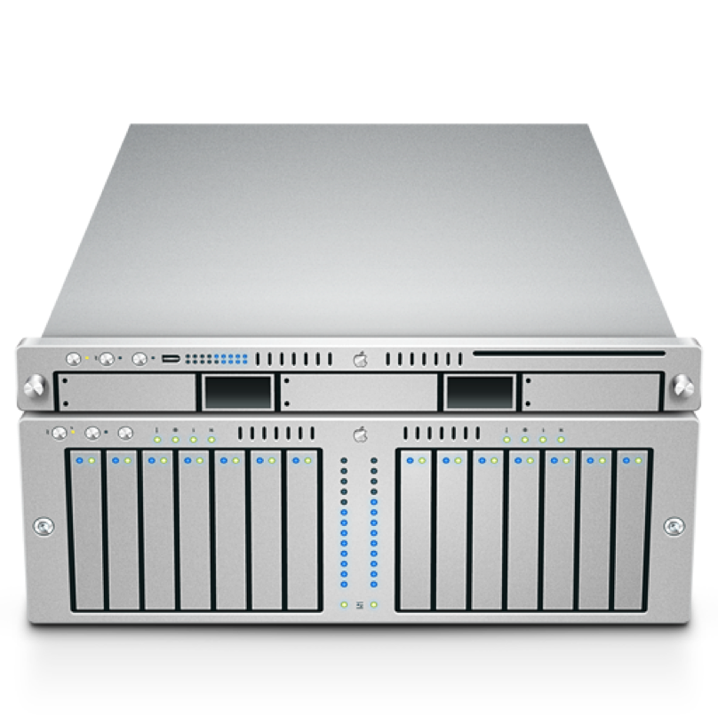

Recurring Solution #1: Partitioning
Partitioning is a common strategy to distributing a system and its data
Starting from a non-distributed system:
All accesses go to single server
A
B
Notes:
Partitioning is the simplest strategy that we can employ to improve the scalability of our system

Slide 9

Recurring Solution #1: Partitioning
Divide data up in some (hopefully logical) way
Makes it easier to process data concurrently (cheaper reads)
Each server has 50% of data, limits amount of processing per server.
Even if 1 server goes down, still have 50% of the data online.
A
[0…100]
B [A…N]
A
[101.. 200]
B [O…Z]
Notes:
With partitioning, we divide up data in some (hopefully logical) way. Deciding how to split this data into partitions can be a tricky problem. One easy way to do this is to use some property of the data: if we have 200 records, and they are indexed from 0… 200, you could envision putting the first 100 on one server, and the next 200 on another. Or, split student records by last name: A..N on one server and O..Z on another.
This can improve scalability because we can now process more requests concurrently: each server holds some subset of our data, and if clients want to touch different pieces of that dataset, they can interact with different machines. Even if one server goes down, the rest of the data would still be available.

Slide 10
Partitioning DNS
Root Servers
Global
Layer
net
org
edu
com
gov
uk
northeastern
Administrational
Layer
root-servers
www
www
khoury
Managerial
Layer
www
Notes:
How many root servers are there?

Slide 11
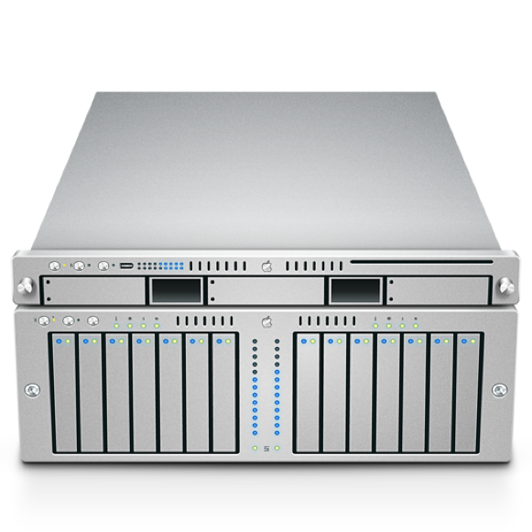

DNS: Example
What might a request look like in practice?
Root
Local DNS Server
course.khoury.neu.edu
ns.edu
course.khoury.neu.edu
.edu
129.10.117.35
course.khoury.neu.edu
ns1.neu.edu
course.khoury.neu.edu
129.10.117.35
neu.edu
ns1.khoury.neu.edu
course.khoury.neu.edu
129.10.117.35
khoury.neu.edu

Slide 12
How to deal with volume?
We successfully distributed requests following the hierarchical nature of domain names
However, e.g., .com is a very popular TLD – there might be (hundreds of) thousands of requests happening at any given time
We may need several nodes just servicing .com
This leads to replication

Slide 13
Recurring Solution #2: Replication
Goal: Any node should be able to process any request
Again, starting from a non-distributed system:
All accesses go to single server
A
B
Notes:
The other recurring solution employed in distributed systems is replication: where we take our service, and take all of that data

Slide 14
Recurring Solution #2: Replication
Entire data set is copied
A
B
A
B
Notes:
And replicate it to multiple servers. In this model, our entire service (and all of the data) is replicated across multiple servers. Ideally, either server can process any request. Hence, we can increase the fault tolerance and performance of our system by having multiple machines that can process requests concurrently, and if one fails, the other can continue to process requests. We can even use this scheme to reduce latency, by placing these replicas in geographically diverse areas. If our replica is physically closer to a client, then it will take less time for a request to get to our server, and a response to get back to the client.

Slide 15
Recurring Solution #2: Replication
Improves performance:
Client load can be evenly shared between servers
Reduces latency: can place copies of data nearer to clients
Improves availability:
One replica fails, still can serve all requests from other replicas

Slide 16
Replication in DNS – Root Servers
Verisign, Inc. | a
Information Sciences Institute | b
Cogent Communications | c
University of Maryland | d
NASA Ames Research Center | e
Internet Systems Consortium, Inc. | f
U.S. DOD Network Information Center | g
U.S. Army Research Lab | h
Netnod | i
Verisign, Inc. | j
RIPE NCC | k
ICANN | l
WIDE Project | m
13 root servers
[a-m].root-servers.org
E.g., d.root-servers.org
Handled by 12 entities
How many physical servers?
a) Less than 13
b) 13
c) Tens
d) Hundreds
e) Thousands
f) Millions

Slide 17
Replication in DNS – Root Servers
Verisign, Inc. | a | 5
Information Sciences Institute | b | 2
Cogent Communications | c | 10
University of Maryland | d | 128
NASA Ames Research Center | e | 191
Internet Systems Consortium, Inc. | f | 193
U.S. DOD Network Information Center | g | 6
U.S. Army Research Lab | h | 2
Netnod | i | 60
Verisign, Inc. | j | 159
RIPE NCC | k | 58
ICANN | l | 157
WIDE Project | m | 9
13 root servers
[a-m].root-servers.org
E.g., d.root-servers.org
Handled by 12 entities
How many physical servers?
a) Less than 13
b) 13
c) Tens
d) Hundreds
980
e) Thousands
f) Millions

Slide 18
Partitioning + Replication
So, DNS combines both partitioning and replication
As do most distributed systems
A
B
Notes:
Of course, most distributed systems combine both partitioning and replication

Slide 19

Partitioning + Replication
A
[0…100]
B [A…N]
A
[0…100]
B [A…N]
A
[0…100]
B [A…N]
A
[101.. 200]
B [O…Z]
A
[101.. 200]
B [O…Z]
A
[101.. 200]
B [O…Z]
Notes:
Where we partition our data, and then replicate those partitions

Slide 20
Partitioning + Replication
A
[0…100]
B [A…N]
A
[0…100]
B [A…N]
A
[0…100]
B [A…N]
A
[0…100]
B [A…N]
A
[0…100]
B [A…N]
A
[0…100]
B [A…N]
A
[101.. 200]
B [O…Z]
A
[101.. 200]
B [O…Z]
A
[101.. 200]
B [O…Z]
A
[101.. 200]
B [O…Z]
A
[101.. 200]
B [O…Z]
A
[101.. 200]
B [O…Z]
DC
NYC
A
[0…100]
B [A…N]
A
[0…100]
B [A…N]
A
[0…100]
B [A…N]
A
[0…100]
B [A…N]
A
[0…100]
B [A…N]
A
[0…100]
B [A…N]
A
[101.. 200]
B [O…Z]
A
[101.. 200]
B [O…Z]
A
[101.. 200]
B [O…Z]
A
[101.. 200]
B [O…Z]
A
[101.. 200]
B [O…Z]
A
[101.. 200]
B [O…Z]
SF
London
Notes:
We can even take this scheme and have arbitrary layers of replication. For instance: we might use the partition + replication scheme from the last slide to organize our system in multiple data centers, where each data center contains its own cluster of machines that partition and replicate the same data. Partitioning and replication are great tools. However, replication is also the source of almost all of the pain in distributed systems.

Slide 21
Replication Problem: Consistency
We probably want our system to work like this
Set A=5
“OK”!
Read A
“5”!
A
B
A
B
6
5
7
6
5
7
Notes:
Replication introduces a new problem, which is: consistency.
Consistency means that all nodes in a replicated system see the same data at the same time.

Slide 22
Sequential Consistency
AKA: Behaves like a single machine would
Set A=5
“OK”!
Read A
“5”!
Set A=5
A
B
“OK!”
A
B
6
5
7
6
5
7
Notes:
How do we implement replication? Let’s see the classic protocol for replicated data between two machines, and maintaining sequential consistency. Sequential consistency is a fancy way of saying, effectively, that clients can read and write data as if they were interacting with a single server, rather than multiple. The property that we need to guarantee is that before we acknowledge the update to 5, we need to ensure that it’s acknowledged by all machines. A simplification of this protocol, then, is: we provisionally update the value to 5, ask the replica to update it, and only once the replica acknowledge the update, we acknowledge it too. Future reads are then guaranteed to see that new value.
We achieved consistency.

Slide 23
Availability
If at least one node is online, can we still answer a request?
Read A
Set A=5
Set A=5
A
B
A
B
5
6
7
6
7
Notes:
Availability means that a failed node does not prevent survivors from continuing to operate.
If a replicated node goes down, we can still answer requests by rerouting to the live nodes.

Slide 24
Consistent + Available
On timeout, assume node is crashed
Read A
Set A=5
“OK”!
“5”!
Set A=5
Assume replica failed
A
B
A
B
6
5
7
6
7
Notes:
We can ensure consistency and availability at the same time. If we detect that a node is down, we complete the update operation and reroute requests to the live nodes.

Slide 25
What if the network fails?
Set A=5
“OK”!
Read A
“6”!
Set A=5
Assume replica failed
A
B
A
B
6
5
7
6
7
Notes:
However what if the connection between the updated node and the replica fails? This is an assumption that we need to keep (our system must tolerate network partition)
Here, we fail to share the updated state, timeout occurs, but the replica is still up and servicing requests.
If we still want to service requests, we assume the replica is down and continue, prioritizing availability and losing consistency.
We could prioritize consistency, but then we would have to stop servicing requests, losing availability.

Slide 26
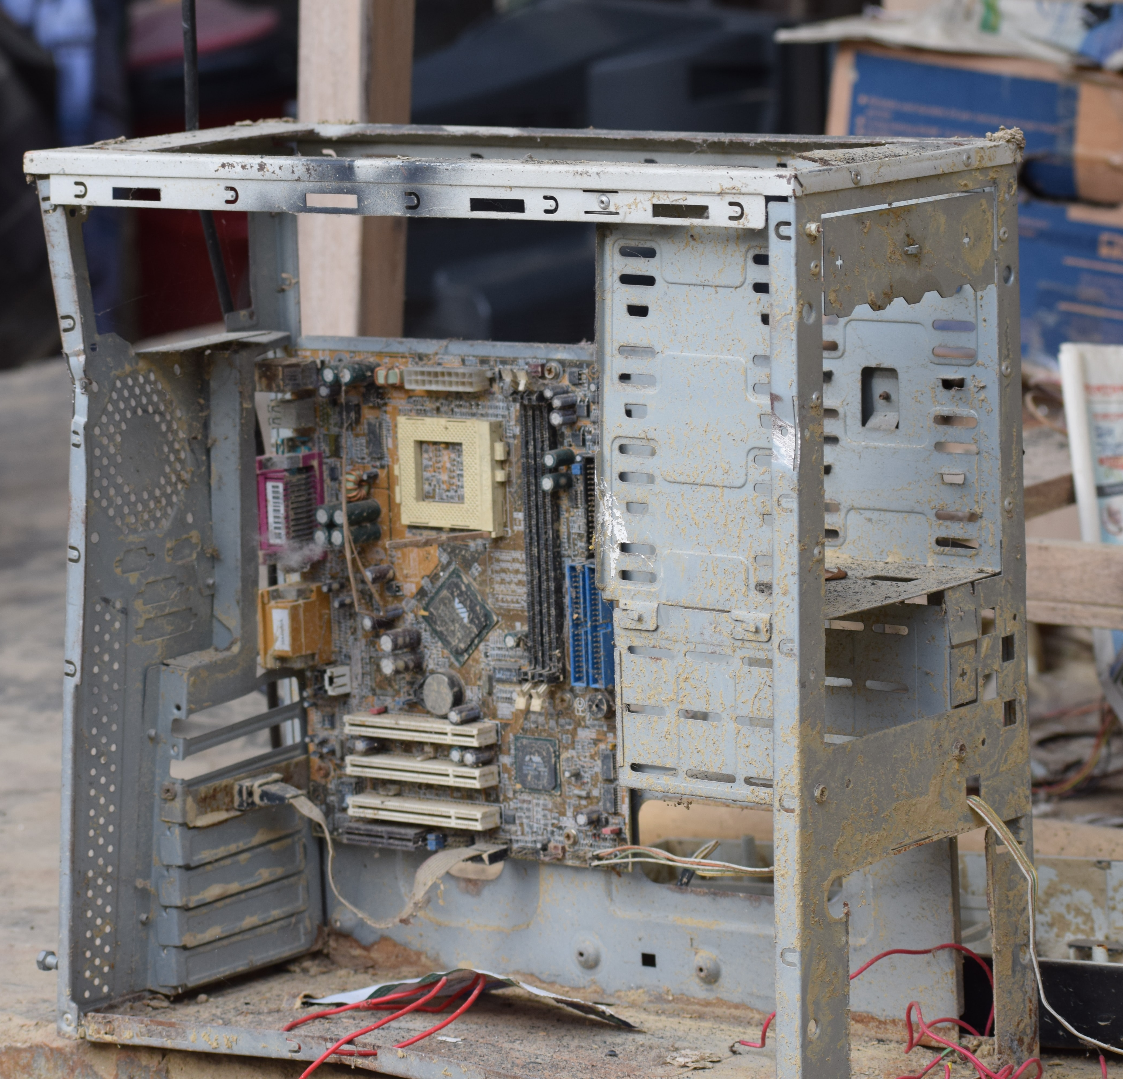
Shared Fate
Are you still there?
Two methods/threads/processes running on the same computer generally have shared fate [Crashed/not]
When two machines in a distributed system can’t talk to each other, how do we know if the other is crashed?
We call this a split brain problem
Notes:
If we want to

Slide 27
CAP Theorem: Consistency or Availability
Pick two of three:
Consistency: All nodes see the same data at the same time (strong consistency)
Availability: Individual node failures do not prevent survivors from continuing to operate
Partition tolerance: The system continues to operate despite message loss (from network and/or node failure)
Can’t drop this for a DS - networks can always fail
Notes:
Emphasize: If we want strong consistency, we won’t be able to achieve the availability we might want

Slide 28
Distributed Software Engineering Abstractions
Key Question: Consistency vs Availability
Distributed system will never match exact semantics of non-distributed system
For replication do we value more: guaranteed consistency (looks like a single machine) or guaranteed availability (sometimes read stale data)?
For a lock server?
For the order of tweets on twitter?
For partitioning: Where can we draw the line?

Slide 29
Byzantine Faults
Unfortunately, still more things can go wrong
Set A=5
“OK”!
Read A
“6”!
Set A=5
A
B
“OK!”
A
B
6
5
7
6
7
Notes:
We can talk more about this kind of failure when we talk about security :)
Main message: Other things fail that could be bugs or something malicious

Slide 30
Learning Objectives for this Lesson
By the end of this lesson, you should be able to…
Describe partitioning and replication as building blocks for distributed systems
Evaluate the tradeoffs between consistency and availability in distributed systems
Answer the question: how does partitioning and replication help us satisfy requirements for distributed systems?

